Slide 1
Capstone project Option 2: Biodiversity for the national parks
By: Dafna Thornbury

Slide 2
Species_info.csv
The original data frame “species_info.csv” has 4 columns: Category, Scientific_name, Common_names and Conservation_status.
Using Nunique we found the number of unique values in the conservations status column. However, at first this figure did not seem correct as we knew that there was > 5000 species in the data frame and only 180 were categorised under the conservation status column. To fixed this we used .fillna and renamed all the null values with “No Intervention” status. Now it made sense.
We used unique to find that there was 7 types of categories of species in the data frame: Mammal, Bird, Reptile, Amphibian, Fish, Vascular Plant and Nonvascular Plant.
We used plt.bar to plot the data in species data frame and found that 97% of the species in our study had a conservation status of “No Intervention” and 3% were “Species of Concern” the rest had a negligible result (> 1%)

Slide 3
Significant calculations
Categorising species as protected and not protected, in reference to the conservation status - we created a new column called ‘is-protected’.
We then pivoted this data and calculated the % of species that were protected by category. The results showed that the highest protected categories were Mammals at 17% followed by Birds at 15% then Amphibians at 8.8% closely followed by Fish at 8.7%
We used a Chi Square test to verify if some categories of animals were more likely to be endangered than others. The first comparison was between mammals and birds. The results of the pval us 0.68 which is higher than 0.05 therefore we can conclude that differences were not significant.
On the other hand when we compared reptiles and mammals we found that the results from the Chi Square test were significant (0.38) Therefore we can conclude that based on the information provided, mammals are more likely to be endangered than reptiles.
When we compared the results from the pivot and the Chi Square test we find that the results are aligned. The difference in percentage of protected mammals and birds were close whereas the difference between mammals and reptiles is significant.

Slide 4
Recommendation for conservationists
Based on the data provided the recommendation to the conservation team would be to prioritise their efforts on the highest engareded risk species. According to our studies these are first mammals and secondly birds.

Slide 5
Sample size determination - foot & mouth disease
The data for the baseline was provided to us as we were told that the only information we had was that 15% of the sheep at Bryce Park had foot and mouth disease. This was our starting point.
Knowing that the scientists want to be able to detect reductions of at least 5 percentage points, we calculated the minimum detectable effect (100* 5/15) which was 33%
Once we have plugged in all the available data (with a statistical significance rate pf 90%) we worked out the optimate sample size of 890.
We found that it would take scientists Yellowstone park 1.75 weeks and ones in Bryce park 3.56 weeks to observe the number of sheep needed for the sample in question.
Referring the the graph we made earlier, it was found that Yellowstone park was the best park to observe the sheep as the most observations per week take place there.

Slide 6
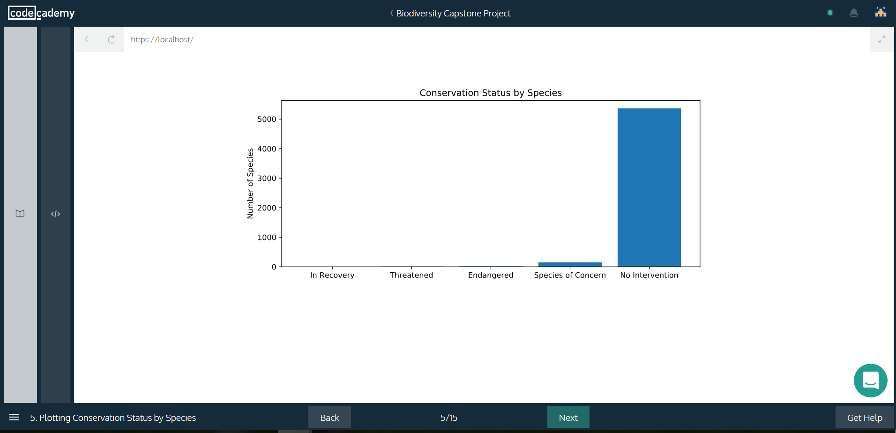
Graph - Conservation status by species

Slide 7
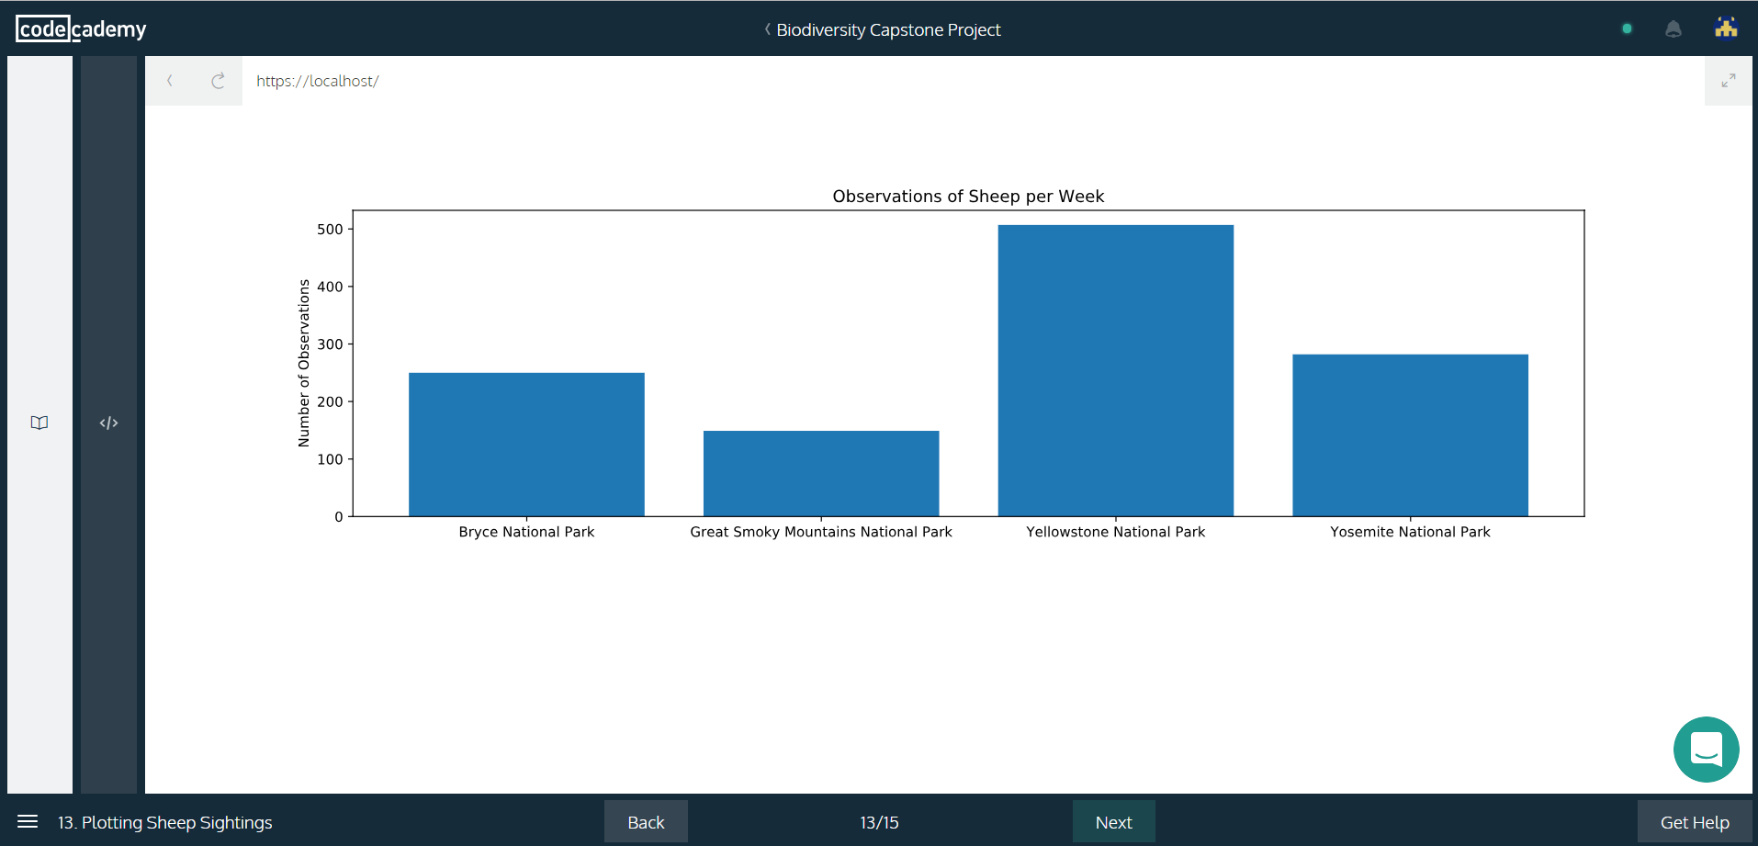
Graph - observations of sheep per week

